Slide 1
Module 1 - Key concepts and trends in Information security
On successful completion of this module, you should be able to:
Define computer security
Describe various types of threats that exist for computers and networks
Discuss recent computer crimes that have been committed
Define basic terms associated with information security
Identify and describe basic approaches to information security
Distinguish and describe various methods used to implement access controls
Describe methods used to verify identity and authenticity of individual users
Describe methods used to conduct social engineering
Recognise and describe some of basic models used to implement security in operating systems.

Slide 2
Module 1 Learning resources
Text Conklin, White, Williams, Davis and Cothren 2016, Principles of Computer Security: CompTIA Security+, 4rd edn.
The readings from the textbook for this module are
chapter 1 'Introduction and Security Trends', pp. 1-17 and
chapter 2 'General Security Concepts', pp. 18-41.

Slide 3
Key Terms
Computer security
Critical infrastructure
Elite hacker
Hacker
Hacking
Hacktivist
Highly structured threat
Information warfare
Script kiddie
Structured threat
Unstructured threat
Notes:
Computer security – In general terms, the methods, techniques, and tools used to ensure that a computer system is secure.
Critical infrastructure – Infrastructure whose loss or impairment would have severe repercussions on society.
Elite hacker – A hacker who has the skill level necessary to discover and exploit new vulnerabilities.
Hacker – A person who performs hacking activities. Hacking – The term used by the media to refer to the process of gaining unauthorized access to computer systems and networks. The term has also been used to refer to the process of delving deep into the code and protocols used in computer systems and networks.
Hacktivist – A hacker who uses his or her skills for political purposes.
Highly structured threat – A threat that is backed by the time and resources to allow virtually any form of attack.
Information warfare – The use of information security techniques, both offensive and defensive, when combating an opponent.
Script kiddie – A hacker with little true technical skill and hence who uses only scripts that someone else developed.
Structured threat – A threat that has reasonable financial backing and can last for a few days or more. The organizational elements allow for greater time to penetrate and attack a system.
Unstructured threat – A threat that has no significant resources or ability—typically an individual with limited skill.

Slide 4
The Computer Security Problem
Fifty years ago companies did not conduct business across the Internet.
Today millions of people perform online transactions every day.
Companies rely on the Internet to operate and conduct business.
Vast amounts of money are transferred via networks, in the form of either bank transactions or simple credit card purchases.
Notes:
Wherever there are vast amounts of money, there are those who will try to take advantage of the environment to conduct fraud or theft.

Slide 5
The Computer Security Problem (continued)
There are many different ways to attack computers and networks.
Identity theft is so common today that most everyone knows somebody who’s been a victim of such a crime, if they haven’t been a victim themselves.
There are many other types of criminal activity and all are on the rise.
Notes:
There are many different ways to attack computers and networks to take advantage of what has made shopping, banking, investment, and leisure pursuits a simple matter of “dragging and clicking” (or tapping) for many people.

Slide 6
Definition of Computer Security
Computer security is not a simple concept to define.
If one is referring to a computer, then it can be considered secure when the computer does what it is supposed to do and only what it is supposed to do.
However, the security emphasis has shifted from the computer to the information being processed.
Information security is defined by the information being protected from unauthorized access or alteration and yet is available to authorized individuals when required.
Notes:
Computer security is not a simple concept to define, and has numerous complexities associated with it.

Slide 7
Definition of Computer Security (continued)
When one begins considering the aspects of information, it is important to realize that information is stored, processed, and transferred between machines, and all of these different states require appropriate protection schemes.
Information assurance is a term used to describe not just the protection of information, but a means of knowing the level of protection that has been accomplished.

Slide 8
Historical Security Incidents
Electronic crime can take a number of different forms, but the ones we will examine here fall into two basic categories:
Crimes in which the computer was the target
Incidents in which a computer was used to perpetrate the act (bank fraud)
Virus activity existed prior to 1988, having started in the early 1980s.
Notes:
By examining some of the computer-related crimes that have been committed over the last 30 or so years, we can better understand the threats and security issues that surround our computer systems and networks.
Prior to 1988, criminal activity was chiefly centered on unauthorized access to computer systems and networks owned by the telephone company and companies that provided dial-up access for authorized users.

Slide 9
Historical Security Incidents (continued)
The Morris Worm (November 1988)
Citibank and Vladimir Levin (June–October 1994)
Kevin Mitnick (February 1995)
Omega Engineering and Timothy Lloyd (July 1996)
Worcester Airport and “Jester” (March 1997)
The Melissa Virus (March 1999)
Notes:
The Morris Worm (November 1988)
Robert Morris, then a graduate student at Cornell University, released what has become known as the Internet worm (or the Morris worm).
The worm infected roughly 10 percent of the machines then connected to the Internet (which amounted to approximately 6000 infected machines).
The worm carried no malicious payload, the program being obviously a “work in progress,” but it did wreak havoc because it continually re-infected computer systems until they could no longer run any programs.
Citibank and Vladimir Levin (June–October 1994)
Starting about June of 1994 and continuing until at least October of the same year, a number of bank transfers were made by Vladimir Levin of St. Petersburg, Russia.
By the time he and his accomplices were caught, they had transferred an estimated $10 million.
Eventually all but about $400,000 was recovered.
Levin reportedly accomplished the break-ins by dialing into Citibank’s cash management system.
This system allowed clients to initiate their own fund transfers to other banks.
Kevin Mitnick (February 1995)
Kevin Mitnick’s computer activities occurred over a number of years during the 1980s and 1990s.
Arrested in 1995, he eventually pled guilty to four counts of wire fraud, two counts of computer fraud, and one count of illegally intercepting a wire communication and was sentenced to 46 months in jail.
In the plea agreement, Mitnick admitted to having gained unauthorized access to a number of different computer systems belonging to companies such as Motorola, Novell, Fujitsu, and Sun Microsystems.
He described using a number of different “tools” and techniques, including social engineering, sniffers, and cloned cellular telephones.
Omega Engineering and Timothy Lloyd (July 1996)
On July 30, 1996, a software “time bomb” went off at Omega Engineering, a New Jersey–based manufacturer of high-tech measurement and control instruments.
Twenty days earlier, Timothy Lloyd, a computer network program designer, had been dismissed from the company after a period of growing tension between Lloyd and management at Omega.
The program that ran on July 30 deleted all of the design and production programs for the company, severely damaging the small firm and forcing the layoff of 80 employees.
The program was eventually traced back to Lloyd, who had left it in retaliation for his dismissal.
Worcester Airport and “Jester” (March 1997)
In March of 1997, telephone services to the FAA control tower as well as the emergency services at the Worcester Airport and the community of Rutland, Massachusetts, were cut off for a period of six hours.
This disruption occurred as a result of an attack on the phone network by a teenage computer “hacker” who went by the name “Jester.”
The Melissa Virus (March 1999)
Melissa is the best known of the early macro-type viruses that attach themselves to documents for programs that have limited macro programming capability.
The virus, written and released by David Smith, infected about a million computers and caused an estimated $80 million in damages.

Slide 10
Historical Security Incidents (continued)
The Love Letter Virus (May 2000)
The Code Red Worm (2001)
The Slammer Worm (2003)
Website Defacements (2006)
Cyberwar? (2007)
Operation Bot Roast (2007)
Conficker (2008–2009)
U.S. Electric Power Grid (1997–2009)
Fiber Cable Cut (2009)
Notes:
The Love Letter Virus (May 2000)
Also known as the “ILOVEYOU” worm and the “Love Bug,” the Love Letter virus was written and released by a Philippine student named Onel de Guzman.
The virus was spread via e-mail with the subject line of “ILOVEYOU.”
Estimates of the number of infected machines worldwide have been as high as 45 million, accompanied by a possible $10 billion in damages (it should be noted that figures like these are extremely hard to verify or calculate).
The Code Red Worm (2001)
On July 19, 2001, in a period of 14 hours, over 350,000 computers connected to the Internet were infected by the Code Red worm.
The cost estimate for how much damage the worm caused (including variations of the worm released on later dates) exceeded $2.5 billion.
The vulnerability was a buffer-overflow condition in Microsoft’s IIS web servers, had been known for a month.
The Slammer Worm (2003)
On Saturday, January 25, 2003, the Slammer worm was released.
It exploited a buffer-overflow vulnerability in computers running Microsoft SQL Server or SQL Server Desktop Engine.
Like the vulnerability in Code Red, this weakness was not new and, in fact, had been discovered and a patch released in July of 2002.
Within the first 24 hours of Slammer’s release, the worm had infected at least 120,000 hosts and caused network outages and the disruption of airline flights, elections, and ATMs.
At its peak, Slammer infected hosts were generating a reported 1TB of worm-related traffic every second.
The worm doubled its number of infected hosts every 8 seconds.
It is estimated that it took less than 10 minutes to reach global proportions and infect 90 percent of the possible hosts it could infect.
Website Defacements (2006)
In May of 2006, a Turkish hacker using the handle iSKORPiTX successfully hacked over 21,000 websites in a single effort.
The rationale for his actions was never determined, and over the next few years he hacked hundreds of thousands of websites, defacing their cover page with a statement of his hack.
A nuisance to some, those affected had to clean up their systems, including repairing vulnerabilities, or he would strike again.
Cyberwar? (2007)
In May of 2007, the country of Estonia was crippled by a massive denial-of-service (DoS) cyberattack against all of its infrastructure, firms (banks), and government offices.
This attack was traced to IP addresses in Russia, but was never clearly attributed to a government-sanctioned effort.
Operation Bot Roast (2007)
In 2007, the FBI announced that it had conducted Operation Bot Roast, identifying over 1 million botnet crime victims.
In the process of dismantling the botnets, the FBI arrested several botnet operators across the United States.Although seemingly a big success, this effort made only a small dent in the vast volume of botnets in operation.
Conficker (2008–2009)
In late 2008 and early 2009, security experts became alarmed when it was discovered that millions of systems attached to the Internet were infected with the Downadup worm.
Also known as Conficker, the worm was believed to have originated in Ukraine.
Infected systems were not initially damaged beyond having their antivirus solution updates blocked.
What alarmed experts was the fact that infected systems could be used in a secondary attack on other systems or networks.
Each of these infected systems was part of what is known as a bot network (or botnet) and could be used to cause a DoS attack on a target or be used for the forwarding of spam e-mail to millions of users.
U.S. Electric Power Grid (1997–2009)
In April 2009, Homeland Security Secretary Janet Napolitano told reporters that the United States was aware of attempts by both Russia and China to break into the U.S. electric power grid, map it out, and plant destructive programs that could be activated at a later date.
She indicated that these attacks were not new and had in fact been going on for years.
One article in the Kansas City Star, for example, reported that in 1997 the local power company, Kansas City Power and Light, encountered perhaps 10,000 attacks for the entire year.
By 2009 the company experienced 30–60 million attacks.
Fiber Cable Cut (2009)
On April 9, 2009, a widespread phone and Internet outage hit the San Jose area in California.
This outage was not the result of a group of determined hackers gaining unauthorized access to the computers that operate these networks, but instead occurred as a result of several intentional cuts in the physical cables that carry the signals.
The cuts resulted in a loss of all telephone, cell phone, and Internet service for thousands of users in the San Jose area.
Emergency services such as 911 were also affected, which could have had severe consequences.

Slide 11
The Current Threat Environment
As time has gone on, more organized elements of cybercrime have entered the picture along with nation-states.
From 2009 and beyond, the cyber threat landscape became considerably more dangerous, with new adversaries out to perform one of two functions:
Deny the use of your computer systems
Use systems for financial gain including theft of intellectual property or financial information including personally identifiable information
Notes:
The threats of the past were smaller, targeted, and in many cases only a nuisance.

Slide 12
The Current Threat Environment (continued)
Advanced Persistent Threats (APTs)
GhostNet (2009)
Operation Aurora (2009)
Stuxnet, Duqu, and Flame (2009–2012)
Sony (2011)
Saudi Aramco (Shamoon) (2012)
Data Breaches (2013–present)
Nation-State Hacking (2013–present)
Notes:
Advanced Persistent Threats
Although there are numerous claims as to when advanced persistent threats (APTs) began and who first coined the term, the important issue is to note that APTs represent a new breed of attack pattern.
Although specific definitions vary, the three words that comprise the term provide the key elements: advanced, persistent, and threat.
Advanced refers to the use of advanced techniques, such as spear phishing, as a vector into a target.
Persistent refers to the attacker’s goal of establishing a long-term, hidden position on a system. Many APTs can go on for years without being noticed.
Threat refers to the other objective: exploitation.
If an adversary invests the resources to achieve an APT attack, they are doing it for some form of long-term advantage.
APTs are not a specific type of attack, but rather the new means by which highly resourced adversaries target systems.
GhostNet (2009)
In 2009, the Dalai Lama’s office contacted security experts to determine if it was being bugged.
The investigation revealed it was, and the spy ring that was discovered was eventually shown to be spying on over 100 countries’ sensitive missions worldwide.
Researchers gave this APT-style spy network the name GhostNet, and although the effort was traced back to China, full attribution was never determined.
Operation Aurora (2009)
Operation Aurora was an APT attack first reported by Google, but also targeting Adobe, Yahoo, Juniper Networks, Rackspace, Symantec, and several major U.S. financial and industrial firms.
Research analysis pointed to the People’s Liberation Army (PLA) of China as the sponsor.
The attack ran for most of 2009 and operated on a large scale, with the groups behind the attack consisting of hundreds of hackers working together against the victim firms.
Stuxnet, Duqu, and Flame (2009–2012)
Stuxnet, Duqu, and Flame represent examples of state-sponsored malware.
Stuxnet was a malicious worm designed to infiltrate the Iranian uranium enrichment program, to modify the equipment and cause the systems to fail in order to achieve desired results and in some cases even destroy the equipment.
Stuxnet was designed to attack a specific model of Siemens programmable logic controller (PLC), which was one of the clues pointing to its objective, the modification of the uranium centrifuges. Although neither the United States nor Israel has admitted to participating in the attack, both have been suggested to have had a role in it.
Duqu (2011) is a piece of malware that appears to be a follow-on of Stuxnet, and has many of the same targets, but rather than being destructive in nature, Duqu is designed to steal information. The malware uses command and control servers across the globe to collect elements such as keystrokes and system information from machines and deliver them to unknown parties.
Flame (2012) is another piece of modular malware that may be a derivative of Stuxnet. Flame is an information collection threat, collecting keystrokes, screenshots, and network traffic. It can record Skype calls and audio signals on a machine. Flame is a large piece of malware with many specific modules, including a kill switch and a means of evading antivirus detection.
Because of the open nature of Stuxnet—its source code is widely available on the Internet—it is impossible to know who is behind Duqu and Flame. In fact, although Duqu and Flame were discovered after Stuxnet, there is growing evidence that they were present before Stuxnet and collected critical intelligence needed to conduct the later attack.
The real story behind these malware items is that they demonstrate the power and capability of nation-state malware.
Sony (2011)
The hacker group LulzSec reportedly hacked Sony, stealing over 70 million user accounts.
The resulting outage lasted 23 days, and cost Sony in excess of $170 million.
One of the biggest issues related to the attack was Sony’s poor response, taking more than a week to notify people of the initial attack, and then communicating poorly with its user base during the recovery period.
Also notable was that although the credit card data was encrypted on Sony’s servers, the rest of the data stolen was not, making it easy pickings for the disclosure of information.
Saudi Aramco (Shamoon) (2012)
In August of 2012, 30,000 computers were shut down in response to a malware attack (named Shamoon) at Saudi Aramco, an oil firm in Saudi Arabia.
The attack hit three out of four machines in the firm, and the damage included data wiping of machines and the uploading of sensitive information to Pastebin.
It took 10 days for the firm to clean up the infection and restart its business network.
Data Breaches (2013–present)
From the end of 2013 through to the time of this writing, data breaches have dominated the security landscape.
Target Corporation announced its breach in mid-December, 2013, stating that the hack began as early as “Black Friday” (November 29) and continued through December 15. Data thieves captured names, addresses, and debit and credit card details, including numbers, expiration dates, and CVV codes. In the end a total of 70 million accounts were exposed.
Following the Target breach, Home Depot suffered a breach of over 50 million debit and credit card numbers in 2014.
JP Morgan Chase also had a major data breach in 2014, announcing the loss of 77 million account holders’ information. Unlike Target and Home Depot, JP Morgan Chase did not lose account numbers or other crucial data elements. JP Morgan Chase also mounted a major PR campaign touting its security program and spending in order to satisfy customers and regulators of its diligence.
At the end of 2014, Sony Pictures Entertainment announced that it had been hacked, with a massive release of internal data. At the time of this writing, hackers have claimed to have stolen as much as 100 terabytes of data, including e-mails, financial documents, intellectual property, personal data, HR information…in essence, almost everything. Additional reports indicate the destruction of data within Sony; although the extent of the damage is not known, at least one of the elements of malware associated with the attack is known for destroying the Master Boot Record (MBR) of drives. Attribution in the Sony attack is also tricky, as the U.S. government has accused North Korea, while other groups have claimed responsibility, and some investigators claim it was an inside job. It may take years to determine correct attribution, if it is even possible.
Nation-State Hacking (2013–present)
Nation-states have become a recognized issue in security, from the Great Firewall of China to modern malware attacks from a wide range of governments.
In 2014 CrowdStrike reported on 39 different threat actors, including criminals, hactivists, state-sponsored groups, and nation-states.
Learning how these adversaries act provides valuable clues to their detection in the enterprise.
Groups such as China’s Hurricane Panda represent a real security threat. Hurricane Panda focuses on aerospace firms and Internet service companies.
Not all threats are from China. Russia is credited with its own share of malware. Attribution is difficult, and sometimes the only hints are clues, such as the timelines of command and control servers for Energetic Bear, an attack on the energy industry in Europe from the Dragonfly group.
In 2015, data breaches and nation-state hacking hit new highs with the loss of over 20 million sensitive personnel files from the computers at the U.S. Office of Personnel Management (OPM). This OPM loss, reportedly to China, was extremely damaging in that the data loss consisted of the complete background investigations on peoples who had submitted security clearances.

Slide 13
Threats to Security
External versus internal threats
Sophistication of the attacks
Script kiddies versus elite hackers
Highly structured threats to unstructured threats
Notes:
There are a number of ways that we can break down the various threats.
One way to categorize them is to separate threats that come from outside of the organization from those that are internal.
Another is to look at the various levels of sophistication of the attacks, from those by “script kiddies” to those by “elite hackers.”
A third is to examine the level of organization of the various threats, from unstructured threats to highly structured threats.
All of these are valid approaches, and they in fact overlap each other.

Slide 14
Viruses and Worms
While your organization may be exposed to viruses and worms as a result of employees not following certain practices or procedures, generally you will not have to worry about your employees writing or releasing viruses and worms.
It is important to draw a distinction between the writers of malware and those who release malware.
Debates over the ethics of writing viruses permeate the industry, but currently, simply writing them is not considered a criminal activity.
Notes:
A virus is like a baseball bat; the bat itself is not evil, but the inappropriate use of the bat (such as to smash a car’s window) falls into the category of criminal activity. (Some may argue that this is not a very good analogy since a baseball bat has a useful purpose—to play ball—but viruses have no useful purpose. In general, this is true, but in some limited environments, such as in specialized computer science courses, the study and creation of viruses can be considered a useful learning experience.)

Slide 15
Viruses and Worms (continued)
By number, viruses and worms are the most common problem that an organization faces because literally thousands of them have been created and released.
Fortunately, antivirus software and system patching can eliminate the largest portion of this threat.
Viruses and worms generally are also nondiscriminating threats.
They typically are also highly visible once released.
Notes:
Viruses and worms generally are also nondiscriminating threats; they are released on the Internet in a general fashion and aren’t targeted at a specific organization. They typically are also highly visible once released, so they aren’t the best tool to use in highly structured attacks where secrecy is vital.

Slide 16
Intruders
The act of deliberately accessing computer systems and networks without authorization is generally referred to as hacking, with individuals who conduct this activity being referred to as hackers.
The term hacking also applies to the act of exceeding one’s authority in a system.
Hacking does not live up to the Hollywood hype.
Intruders are extremely patient.
Process takes persistence and dogged determination
Notes:
Hacking includes authorized users who attempt to gain access to files they aren’t permitted to access or who attempt to obtain permissions that they have not been granted.
The attacker will conduct many pre-attack activities in order to obtain the information needed to determine which attack will most likely be successful. Typically, by the time an attack is launched, the attacker will have gathered enough information to be very confident that the attack will succeed.

Slide 17
Intruders (continued)
Generally, attacks by an individual or even a small group of attackers fall into the unstructured threat category.
Attacks at this level generally are conducted over short periods of time (lasting at most a few months), do not involve a large number of individuals, have little financial backing, and are accomplished by insiders or outsiders who do not seek collusion with insiders.

Slide 18
Intruders (continued)
Intruders definitely come in many different varieties and have varying degrees of sophistication.
Script kiddies do not have the technical expertise to develop scripts or discover new vulnerabilities in software.
At the next level are those people who are capable of writing scripts to exploit known vulnerabilities.
At the top are those highly technical individuals, often referred to as elite hackers.
Notes:
At the low end technically are what are generally referred to as script kiddies, individuals who do not have the technical expertise to develop scripts or discover new vulnerabilities in software but who have just enough understanding of computer systems to be able to download and run scripts that others have developed. These individuals generally are not interested in attacking specific targets, but instead simply want to find any organization that may not have patched a newly discovered vulnerability for which the script kiddie has located a script to exploit the vulnerability.
At the next level are those people who are capable of writing scripts to exploit known vulnerabilities. These individuals are much more technically competent than script kiddies and account for an estimated 8 to 12 percent of malicious Internet activity.
At the top end of this spectrum are those highly technical individuals, often referred to as elite hackers, who not only have the ability to write scripts that exploit vulnerabilities but also are capable of discovering new vulnerabilities. This group is the smallest of the lot, however, and is responsible for, at most, only 1 to 2 percent of intrusive activity.

Slide 19
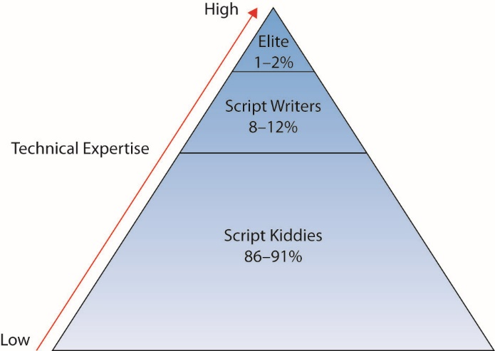
Figure 1.1 Distribution of attacker skill levels

Slide 20
Insiders
It is generally acknowledged by security professionals that insiders are more dangerous in many respects than outside intruders.
Insiders have the access and knowledge necessary to cause immediate damage to an organization.
Insiders frequently have knowledge of the security systems in place and are better able to avoid detection.
Often, numerous other individuals have physical access to company facilities.
Custodial crews, contractors or partners
Notes:
Most security is designed to protect against outside intruders and thus lies at the boundary between the organization and the rest of the world. Insiders may actually already have all the access they need to perpetrate criminal activity such as fraud. Attacks by insiders are often the result of employees who have become disgruntled with their organization and are looking for ways to disrupt operations. It is also possible that an “attack” by an insider may be an accident and not intended as an attack at all. An example of this might be an employee who deletes a critical file without understanding its critical nature.
A contractor involved in U.S. Intelligence computing, Edward Snowden, was charged with espionage in 2013 after he released a wide range of data illustrating the technical capabilities of U.S. intelligence surveillance systems. He is the ultimate insider with his name becoming synonymous with the insider threat issue.

Slide 21
Criminal Organizations
Criminal activity on the Internet is basically no different from criminal activity in the physical world.
One difference is the level of organization that criminal elements employ in their attack.
Attacks by criminal organizations usually fall into the structured threat category.
Characterized by a greater amount of planning, a longer period of time to conduct the activity, more financial backing to accomplish it, and possibly corruption of, or collusion with, insiders
Notes:
As businesses became increasingly reliant upon computer systems and networks, and as the amount of financial transactions conducted via the Internet increased, it was inevitable that criminal organizations would eventually turn to the electronic world as a new target to exploit. Fraud, extortion, theft, embezzlement, and forgery all take place in the electronic environment.
Criminal groups typically have more money to spend on accomplishing the criminal activity and are willing to spend extra time accomplishing the task provided the level of reward at the conclusion is great enough. With the tremendous amount of money that is exchanged via the Internet on a daily basis, the level of reward for a successful attack is high enough to interest criminal elements.

Slide 22
Nation-States, Terrorists, and Information Warfare
Many nations today have developed to some extent the capability to conduct information warfare.
Warfare conducted against the information and information processing equipment used by an adversary
Information warfare falls into the highly structured threat category.
Characterized by a much longer period of preparation (years is not uncommon), tremendous financial backing, and a large and organized group of attackers.
Notes:
As nations have increasingly become dependent on computer systems and networks, the possibility that these essential elements of society might be targeted by organizations or nations determined to adversely affect another nation has become a reality.
In practice, this is a much more complicated subject, because information not only may be the target of an adversary, but also may be used as a weapon. The threat may include attempts not only to subvert insiders but also to plant individuals inside of a potential target in advance of a planned attack.

Slide 23
Nation-States, Terrorists, and Information Warfare (continued)
An interesting aspect of information warfare is the list of possible targets available.
Military forces are still a key target in information warfare.
Critical infrastructures are those whose loss would have severe repercussions on the nation.
Water, electricity, oil and gas refineries and distribution, banking and finance, telecommunications
Dependent on computer systems
Notes:
We have grown accustomed to the idea that, during war, military forces will target opposing military forces but will generally attempt to destroy as little civilian infrastructure as possible.
With countries relying so heavily on these critical infrastructures, it is inevitable that they will be viewed as valid targets during conflict. Given how dependent these infrastructures are on computer systems and networks, it is also inevitable that these same computer systems and networks will be targeted for a cyberattack in an information war.

Slide 24
Security Trends
The computing environment has transformed from large mainframes to a highly interconnected network of smaller systems.
There is a switch from a closed operating environment to one in which access to a computer can occur from almost anywhere on the planet.
This has, for obvious reasons, greatly complicated the job of the security professional.
The attackers have become more focused on gain over notoriety.
Notes:
The type of individual who attacks a computer system or network has also evolved over the last 30 years. Today computer attacks are used to steal and commit fraud and other crimes in the pursuit of monetary enrichment. Computer crimes are big business today, not just because it is hard to catch the perpetrators, but also because the number of targets is large and the rewards greater than robbing local stores.

Slide 25
Security Trends (continued)
The type of individual who attacks a computer system or network has evolved over the last 30 years.
Today computer attacks are used to steal and commit fraud and other crimes in the pursuit of monetary enrichment.
Computer crimes are big business today, not just because it is hard to catch the perpetrators, but also because the number of targets is large and the rewards greater than robbing local store.
Notes:
Over the past several years a wide range of computer industry firms have begun issuing annual security reports. Among these firms is Verizon, which has issued its annual Data Breach Investigations Report (DBIR) since 2008 and is lauded because of its breadth and depth. The 2015 DBIR was based on over 2,100 data breaches and 79,790 security incidents in 61 countries. Perhaps the most valuable aspect of the DBIR is its identification of common details that result in a data breach. The Verizon DBIRs are available at www.verizonenterprise.com/DBIR/

Slide 26
Targets and Attacks
There are two general reasons a particular system is attacked:
It is specifically targeted by the attacker.
It is an opportunistic target.

Slide 27
Specific Target
The attacker has chosen the target not because of the hardware or software the organization is running but for another reason, perhaps a political reason.
Examples:
An individual in one country attacking a government system in another
The attacker targeting the organization as part of a hacktivist attack
Company website that sells fur coats defaced because the attacker feels that using animals in this way is unethical

Slide 28
Opportunistic Target
Attack is conducted against a site that has software that is vulnerable to a specific exploit.
The attackers are not targeting the organization.
They have learned of a vulnerability and are simply looking for an organization with this vulnerability that they can exploit.
An attacker might be targeting a given sector and looking for a target of opportunity in that sector.
Targeted attacks are more difficult and take more time than attacks on a target of opportunity.
Notes:
This is not to say that an attacker might not be targeting a given sector and looking for a target of opportunity in that sector, however. For example, an attacker may desire to obtain credit card or other personal information and may search for any exploitable company with credit card information in order to carry out the attack.
Targeted attacks are more difficult and take more time than attacks on a target of opportunity. The latter simply relies on the fact that with any piece of widely distributed software, there will almost always be somebody who has not patched the system (or has not patched it properly) as they should have.

Slide 29
Minimizing Possible Avenues of Attack
There are multiple elements to a solid computer defense, but two of the key elements involve limiting an attacker’s avenues of attack.
The first step an administrator can take to reduce possible attacks is to ensure that all patches for the operating system and applications are installed.
The second step an administrator can take is system hardening, which involves limiting the services that are running on the system.
Notes:
Understanding the steps an attacker will take enables you to limit the exposure of your system and minimize those avenues an attacker might possibly exploit. The first step an administrator can take to reduce possible attacks is to ensure that all patches for the operating system and applications are installed. Many security problems that we read about, such as viruses and worms, exploit known vulnerabilities for which patches exist. The reason such malware caused so much damage in the past was that administrators did not take the appropriate actions to protect their systems.
The second step an administrator can take is system hardening, which involves limiting the services that are running on the system. Only using those services that are absolutely needed does two things: it limits the possible avenues of attack (those services with vulnerabilities that can be exploited), and it reduces the number of services the administrator has to worry about patching in the first place. This is one of the important first steps any administrator should take to secure a computer system. System hardening is covered in detail in Chapter 14.
While there are no iron-clad defenses against attack, or guarantees that an attack won’t be successful, you can take steps to reduce the risk of loss. This is the basis for the change in strategy from a defense-based one to one based on risk management. Risk management is covered in detail in Chapter 20.

Slide 30
Approaches to Computer Security
Correctness
Ensuring that a system is fully up to date, with all patches installed and proper security controls in place; this goes a long way toward minimizing risk.
Isolation
Protecting a system from unauthorized use, by means of access control and physical security.
Obfuscation
Making it difficult for an adversary to know when they have succeeded.

Slide 31
Ethics
Ethics is commonly defined as a set of moral principles that guides an individual’s or group’s behavior.
Because information security efforts frequently involve trusting people to keep secrets that could cause harm to the organization if revealed, trust is a foundational element in the people side of security.
Trust is built upon a code of ethics, a norm that allows everyone to understand expectations and responsibilities.
Notes:
Any meaningful discussion about operational aspects of information security must include the topic of ethics. There are several different ethical frameworks that can be applied to making a decision, and these are covered in detail in Chapter 25.
Ethics is a difficult topic; separating right from wrong is easy in many cases, but in other cases it is more difficult. For example, writing a virus that damages a system is clearly bad behavior, but is writing a worm that goes out and patches systems, without the users’ permission, right or wrong? Does the ends justify the means? Such questions are the basis of ethical discussions that define the challenges faced by security personnel on a regular basis.

Slide 32
Key Terms
*-property
Access control
Auditability
Authentication
Availability
Bell-LaPadula security model
Biba security model
Brewer-Nash security model
Clark-Wilson security model
Complete mediation
Confidentiality
Default deny
Diversity of defense
Notes:
*-property – Pronounced “star property,” this aspect of the Bell–LaPadula security model is commonly referred to as the “no-write-down” rule because it doesn’t allow a user to write to a file with a lower security classification, thus preserving confidentiality.
Access control – Mechanism or method used to determine what access permissions subjects (such as users) have for specific objects (such as files).
Auditability – The property of an item that make it available for verification upon inspection.
Authentication – The process by which a subject’s (such as a user’s) identity is verified.
Availability – Part of the “CIA” of security. Availability applies to hardware, software, and data, specifically meaning that each of these should be present and accessible when the subject (the user) wants to access or use them.
Bell-LaPadula security model – A computer security model built around the property of confidentiality and characterized by no-read-up and no-write-down rules.
Biba security model – An information security model built around the property of integrity and characterized by no-write-up and no-read-down rules.
Brewer-Nash security model – A computer security model defined by controlling read and write access based on conflict of interest rules.
Clark-Wilson security model – A security model that uses transactions and a differentiation of constrained data items (CDI) and unconstrained data items (UDI).
Complete mediation – The principle that protection mechanisms should cover every access to every object.
Confidentiality – Part of the CIA of security. Refers to the security principle that states that information should not be disclosed to unauthorized individuals.
Default deny – The use of an overarching rule that if not explicitly permitted, permission will be denied.
Diversity of defense – The approach of creating dissimilar security layers so that an intruder who is able to breach one layer will be faced with an entirely different set of defenses at the next layer.

Slide 33
Key Terms (continued)
Economy of mechanism
Fail-safe defaults
Hacking
Host security
Implicit deny
Integrity
Layered security
Least common mechanism
Least privilege
Low-Water-Mark policy
Network security
Nonrepudiation
Open design
Operational model of computer security
Phreaking
Notes:
Economy of mechanism – The principle that designs should be small and simple.
Fail-safe defaults – The principle that when a system fails, the default failure state will be a safe state by design.
Hacking – The term used by the media to refer to the process of gaining unauthorized access to computer systems and networks. The term has also been used to refer to the process of delving deep into the code and protocols used in computer systems and networks. See also cracking.
Host security – Security functionality that is present on a host system.
Implicit deny – A situation that is different than normal for a specific circumstance.
Integrity – Part of the CIA of security, the security principle that requires that information is not modified except by individuals authorized to do so.
Layered security – The arrangement of multiple layers of defense, a form of defense in depth.
Least common mechanism – The principle where protection mechanisms should be shared to the least degree possible among users.
Least privilege – A security principle in which a user is provided with the minimum set of rights and privileges that he or she needs to perform required functions. The goal is to limit the potential damage that any user can cause.
Low-Water-Mark policy – An integrity-based information security model derived from the Bell–LaPadula model.
Network security – Protection of multiple computers and other devices that connect together. An emphasis is placed on controlling access to internal computers from external entities.
Nonrepudiation – The ability to verify that an operation has been performed by a particular person or account. This is a system property that prevents the parties to a transaction from subsequently denying involvement in the transaction.
Open design – The principle that protection mechanisms should not depend upon secrecy of design for security.
Operational model of computer security – Structuring activities into prevention, detection, and response.
Phreaking – Used in the media to refer to the hacking of computer systems and networks associated with the phone company. See also cracking.

Slide 34
Key Terms (continued)
Psychological acceptability
Ring policy
Security through obscurity
Separation of duties
Separation of privilege
Simple Security Rule
Notes:
Psychological acceptability – The principle that protection mechanisms should not impact users, or if they do, the impact should be minimal.
Ring policy – Part of the Biba security model, a policy that allows any subject to read any object without regard to the object’s level of integrity and without lowering the subject’s integrity level.
Security through obscurity – An approach to security using the mechanism of hiding information to protect it.
Separation of duties – A basic control that prevents or detects errors and irregularities by assigning responsibilities to different individuals so that no single individual can commit fraudulent or malicious actions.
Separation of privilege – A security design principle stating access should be based on more than one item. States that critical items should require multiple parties.
Simple Security Rule – The principle that states complexity makes security more difficult and hence values simplicity.

Slide 35
Basic Security Terminology
The term hacking is used frequently in the media.
Hacker was once an individual you turned to when you had a problem and needed extreme technical expertise.
Today, hacker refers to individuals who attempt to gain unauthorized access to computer systems or networks.
Also known as cracker and cracking.
Phreaking
The “hacking” of the systems and computers used by a telephone company to operate its telephone network.

Slide 36
Security Basics
Computer security
Entails methods used to ensure a secure system
Must address authentication and access controls in broad terms of computer security
Network security
Protection of multiple computers and other devices that connect together
Information security and information assurance
These place focus of the security process on the data.
Assurance refers to systems and information availability.
Notes:
Computer security itself is a term that has many meanings and related terms. Subjects such as authentication and access controls must be addressed in broad terms of computer security. Seldom in today’s world are computers not connected to other computers in networks.
Information security and information assurance, place the focus of the security process not on the hardware and software being used but on the data that is processed by them. Assurance also introduces another concept, that of the availability of the systems and information when we want them.

Slide 37
Security Basics (continued)
Cybersecurity is the term used to describe the field covering availability of the systems and information when we want them.
COMSEC (communications security) deals with the security of telecommunication systems.
Cybersecurity is a regular topic in headline news.
Led to terms hacking, virus, TCP/IP, encryption, and firewalls in casual conversations
Notes:
Cybersecurity has become regular headline news these days, with reports of break-ins, data breaches, fraud, and a host of other calamities. The general public has become increasingly aware of its dependence on computers and networks and consequently has also become interested in the security of these same computers and networks. As a result of this increased attention by the public, several new terms have become commonplace in conversations and print.
With our increased daily dependence on computers and networks to conduct everything from making purchases at our local grocery store, banking, trading stocks, and receiving medical treatment to driving our children to school, ensuring that computers and networks are secure has become of paramount importance. Computers and the information they manipulate has become a part of virtually every aspect of our lives.

Slide 38
The “CIA” of Security
CIA
Confidentiality ensures that only those individuals who have the authority to view a piece of information may do so.
Integrity deals with the generation and modification of data. Only authorized individuals should ever be able to create or change (or delete) information.
Availability ensures that the data, or the system itself, is available for use when the authorized user wants it.
Notes:
Tech Tip: CIA of Security
While there is no universal agreement on authentication, auditability, and nonrepudiation as additions to the original CIA of security, there is little debate over whether confidentiality, integrity, and availability are basic security principles. Understand these principles, because one or more of them are the reason most security hardware, software, policies, and procedures exist.

Slide 39
The “CIA” of Security (continued)
Two additional CIA security goals
Authentication attempts to ensure that an individual is who they claim to be.
Nonrepudiation deals with the ability to verify that a message has been sent and received and that the sender can be identified and verified.
Recent emphasis on systems assurance
Auditability refers to whether a control can be verified to be functioning properly.

Slide 40
The Operational Model of Computer Security
Prevention, the focus of security for many years
Protection was equated with prevention.
Somebody always seems to find a way around safeguards.
Operational model of computer security
One security equation is: Protection = Prevention + (Detection + Response)
Every security technique and technology falls into at least one of the three elements of the equation.
Notes:
We need multiple prevention techniques and also technology to alert us when prevention has failed and to provide ways to address the problem. This results in a modification to our original security equation with the addition of two new elements—detection and response.
Our security equation thus becomes: Protection = Prevention + (Detection + Response)

Slide 41
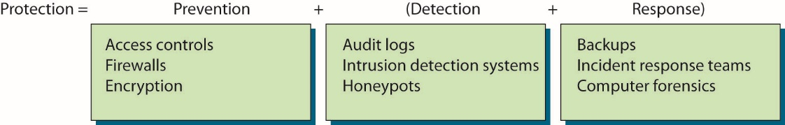
Figure 2.1 Sample technologies in the operational model of computer security

Slide 42
Cybersecurity Framework Model
Framework for Improving Critical Infrastructure Cybersecurity
It provides a common taxonomy and mechanism to assist in aligning management practices with existing standards, guidelines, and practices.
Its purpose is to complement and enhance risk management efforts.
It is composed of five core functions.
Identify, protect, detect, respond and recover
Tiers represent the organizations’ ability from Partial (Tier 1) to Adaptive (Tier 4)
Notes:
In 2013, President Obama signed an executive order directing the U.S. National Institute of Science and Technology (NIST) to work with industry and develop a cybersecurity framework. This was in response to several significant cybersecurity events where the victim companies appeared to be unprepared. The resulting framework, titled Framework for Improving Critical Infrastructure Cybersecurity, was created as a voluntary system.
Its purpose is to complement and enhance risk management efforts through:
Determining their current cybersecurity posture
Documenting their desired target state with respect to cybersecurity
Determining and prioritizing improvement and corrective actions
Measuring and monitoring progress toward goals
Creating a communication mechanism for coordination among stakeholders

Slide 43
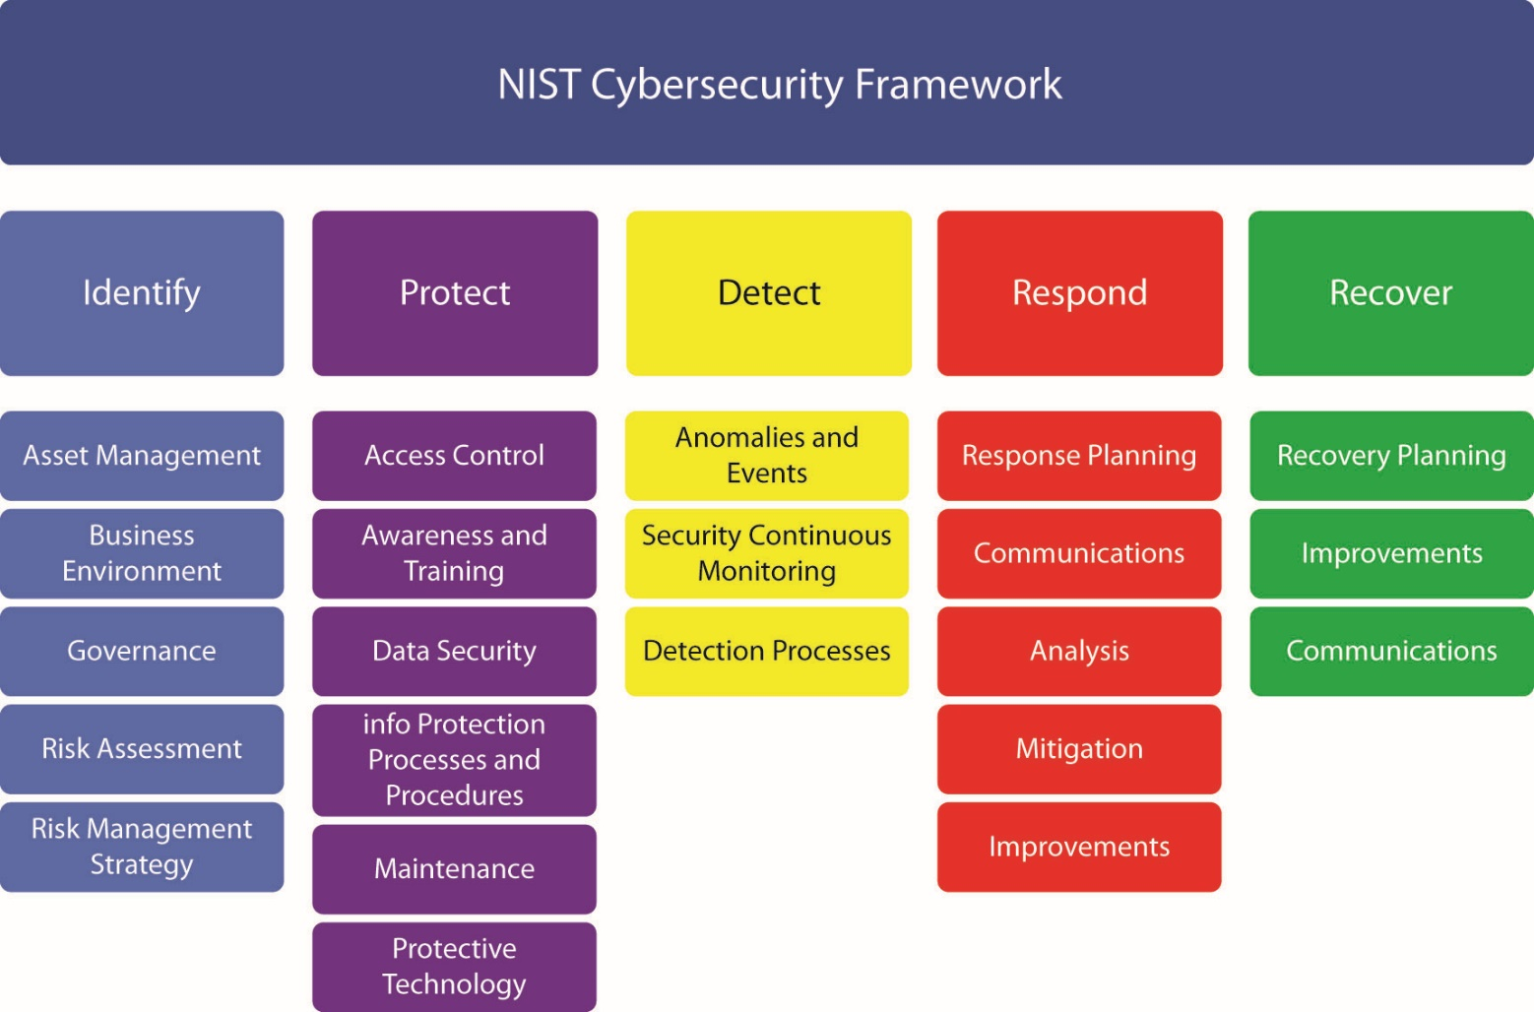
Figure 2.2 Cybersecurity Framework core functions
Notes:
Tech Tip: Cybersecurity Framework
The NIST Cybersecurity Framework is a risk-based approach to implementation of cybersecurity activities in an enterprise. The framework provides a common taxonomy of standards, guidelines, and practices that can be employed to strengthen cybersecurity efforts.
Identify and Protect, describe actions taken before an incident. Detect is the core function associated with intrusion detection or the beginning of an incident response. The last two, Respond and Recover detail actions that take place during the post-incident response.
In addition to the five functions, the framework has levels of implementations referred to as tiers. These tiers represent the organization’s ability from Partial (Tier 1) to Adaptive (Tier 4).

Slide 44
Security Tenets
Session management is a set of activities employed to establish a communication channel between two parties.
Application authenticates once and has subsequent activities ascribed to the authenticated user.
Sessions frequently used in web applications to preserve state and user information between normally stateless clicks.
Sessions typically identified by an ID known to both sides.
Management includes all activities necessary to manage the session.
Notes:
Note: ID can be used as a token for future identification. If confidentiality is required, then the channel should be secured by an appropriate level of cryptographic protection.
Session management includes all the activities necessary to manage the session, from establishment, during use, and at completion of the conversation. Because the session represents the continuity of a security condition established during authentication, the level of protection that should be afforded to the session ID should be commensurate with the level of security initially established.

Slide 45
Security Tenets (continued)
Exception management is the management of changes to normal processing.
Exception handling is an important consideration during software development.
Must effectively handle system operation exceptions.
Sometimes operate outside normal policy limits
It can be nontechnical in nature.
System must handle the condition and recover, or it must fail and be recovered by separate action.
Notes:
Exceptions are the invocation of conditions that fall outside the normal sequence of operation. Whether by error or malicious action, exceptions are changes to normal processing and need to be managed. The special processing required by conditions that fall outside normal parameters can result in errors either locally or in follow-on processes in a system.

Slide 46
Security Tenets (continued)
Configuration management involves the design and operation of the elements to ensure the proper functional environment of a system.
Key to proper IT systems operation
Essential to the proper operation of the system

Slide 47
Security Approaches
Ignore security issues
Minimal amount of security provided with devices
Provide host security
Prevention and detection and response components
Provide network-level security
Prevention and detection and response components
Combine host and network-level security
Mature organization uses both in a complementary fashion
Notes:
If an organization decides to ignore security, it has chosen to utilize the minimal amount of security that is provided with its workstations, servers, and devices. No additional security measures will be implemented. Each “out of the box” system has certain security settings that can be configured, and they should be. To actually protect an entire network, however, requires work in addition to the few protection mechanisms that come with systems by default.

Slide 48
Security Approaches (continued)
Host security takes a granular view of security.
It focuses on protecting each computer and device individually instead of addressing protection of the network as a whole.
Each computer protects itself.
Without network security, there is a high probability of introducing or overlooking vulnerabilities.
Notes:
Most environments are filled with different operating systems (Windows, UNIX, Linux, OS X), different versions of those operating systems, and different types of installed applications. Each operating system has security configurations that differ from those of other systems, and different versions of the same operating system may in fact have configuration variations between them.
Host security is important and should always be addressed. Security, however, should not stop there, as host security is a complementary process to be combined with network security. If individual host computers have vulnerabilities embodied within them, then network security can provide another layer of protection that will, hopefully, stop any intruders who have gotten that far into the environment.

Slide 49
Security Approaches (continued)
Network Security
Emphasis is placed on controlling access to internal computers from external entities.
It is controlled through devices.
Routers, firewalls, authentication hardware and software, encryption, and intrusion detection systems (IDSs)
Notes:
In some smaller environments, host security by itself may be an option, but as systems become connected into networks, security should include the actual network itself.
Network environments tend to be unique entities because usually no two networks have exactly the same number of computers, the same applications installed, the same number of users, the exact same configurations, or the same available servers. They will not perform the same functions or have the same overall architecture. Since networks have so many variations, there are many different ways in which they can be protected and configured. This chapter covers some foundational approaches to network and host security. Each approach may be implemented in a myriad of ways, but both network and host security need to be addressed for an effective total security program.

Slide 50
Security Principles
Least privilege
Subject (user, application, or process) should have only the necessary rights and privileges to perform its task with no additional permissions.
By limiting an object's privilege, we limit the amount of harm that can be caused.
Trust relationships should be created for specific reasons.
The security context in which an application runs should be limited to that which is needed for that program to perform its duties successfully.
Notes:
One of the most fundamental principles in security is least privilege. This concept is applicable to many physical environments as well as network and host security.
Users may have access to the files on their workstations and a select set of files on a file server, but no access to critical data that is held within the database. This rule helps an organization protect its most sensitive resources and helps ensure that whoever is interacting with these resources has a valid reason to do so.
The concept of least privilege applies to more network security issues than just providing users with specific rights and permissions. When trust relationships are created, they should not be implemented in such a way that everyone trusts each other simply because it is easier. One domain should trust another for very specific reasons, and the implementers should have a full understanding of what the trust relationship allows between two domains. If one domain trusts another, do all of the users automatically become trusted, and can they thus easily access any and all resources on the other domain? Is this a good idea? Is there a more secure way of providing the same functionality? If a trusted relationship is implemented such that users in one group can access a plotter or printer that is available in only one domain, it might make sense to simply purchase another plotter so that other, more valuable or sensitive resources are not accessible by the entire group.
Another issue that falls under the least privilege concept is the security context in which an application runs. All applications, scripts, and batch files run in the security context of a specific user on an operating system. They execute with specific permissions as if they were a user. The application may be Microsoft Word and run in the space of a regular user, or it may be a diagnostic program that needs access to more sensitive system files and so must run under an administrative user account, or it may be a program that performs backups and so should operate within the security context of a backup operator. The crux of this issue is that a program should execute only in the security context that is needed for that program to perform its duties successfully. In many environments, people do not really
understand how to make programs run under different security contexts, or it may just seem easier to have all programs run under the administrator account. If attackers can compromise a program or service running under the administrator account, they have effectively elevated their access level and have much more control over the system and many more ways to cause damage.

Slide 51
Security Principles (continued)
Separation of privilege states that a protection mechanism should be constructed so that it uses more than one piece of information to make access decisions.
Separation of duties is the application of separation of privilege to the people side of the security function.
More than one individual needs to be involved.
It is applicable to physical environments as well as network and host security.
Notes:
When applied to people’s actions, separation of duties specifies that for any given task, more than one individual needs to be involved. The task is broken into different duties, each of which is accomplished by a separate individual. By implementing a task in this manner, no single individual can abuse the system for his or her own gain. This principle has been implemented in the business world, especially financial institutions, for many years. A simple example is a system in which one individual is required to place an order and a separate person is needed to authorize the purchase.

Slide 52
Security Principles (continued)
Separation of privilege provides a certain level of checks and balances.
Chief drawback is cost required to accomplish the task.
Manifested in both time and money
Requires more than one individual when a single person could accomplish the task
Expected delay with more than one individual involved

Slide 53
Security Principles (continued)
Fail-safe defaults is a concept that when something fails, it should do so to a safe state.
Default deny
Deny access by default, and grant access only when explicit permission exists.
Common operational term for this approach is implicit deny.
Implicit deny applies to situations involving both authorization and access.
The alternative to implicit deny is to allow access unless a specific rule forbids it.
Notes:
Frequently in the network world, administrators make many decisions concerning network access. Often a series of rules will be used to determine whether or not to allow access (which is the purpose of a network firewall). If a particular situation is not covered by any of the other rules, the implicit deny approach states that access should not be granted. In other words, if no rule would allow access, then access should not be granted. Implicit deny applies to situations involving both authorization and access.
The alternative to implicit deny is to allow access unless a specific rule forbids it. Another example of these two approaches is in programs that monitor and block access to certain web sites. One approach is to provide a list of specific sites that a user is not allowed to access. Access to any site not on the list would be implicitly allowed. The opposite approach (the implicit deny approach) would block all access to sites that are not specifically identified as authorized. As you can imagine, depending on the specific application, one or the other approach will be more appropriate. Which approach you choose depends on the security objectives and policies of your organization.

Slide 54
Security Principles (continued)
Economy of mechanism is described as always using simple solutions when available.
Protection mechanism should be small and simple.
An example is the number of services allowed to run.
Keep-it-simple principle tells us to eliminate or disable those services that we don’t need.
General rule of thumb is to eliminate or disable all nonessential services and protocols.
It is difficult to determine nonessential services.
A stringent security assumes that no service is necessary.
Notes:
The terms security and complexity are often at odds with each other, because the more complex something is, the harder it is to understand, and you cannot truly secure something if you do not understand it. Another reason complexity is a problem within security is that it usually allows too many opportunities for something to go wrong. If an application has 4000 lines of code, there are a lot fewer places for buffer overflows, for example, than in an application of two million lines of code.

Slide 55
Security Principles (continued)
Complete mediation refers to the concept that each and every request should be verified.
When permissions are verified the first time, and the result is cached for subsequent use, performance may be increased.
Also opens the door to permission errors.
This concept also refers to ensuring that all operations go through the protection mechanism.
Notes:
One of the fundamental tenets of a protection system is to check all access requests for permission. Each and every time a subject requests access to an object, the permission must be checked; otherwise an attacker might gain unauthorized access to an object.
Complete mediation also refers to ensuring that all operations go through the protection mechanism. When security controls are added after the fact, it is important to make certain that all process flows are covered by the controls, including exceptions and out-of-band requests. If an automated process is checked in one manner, but a manual paper backup process has a separate path, it is important to ensure all checks are still in place. When a system undergoes disaster recovery or business continuity processes, or backup and/or restore processes, these too require complete mediation.

Slide 56
Security Principles (continued)
Open design holds that the protection of an object should not rely upon secrecy of the protection mechanism itself.
Long proven in cryptographic circles
Security through obscurity is considered effective if the environment and protection mechanisms are confusing or thought to be not generally known.
Protect something by hiding it
Considered to be a poor approach
Notes:
The principle does not exclude the idea of using secrecy, but merely states that, on the face of it, secrecy of mechanism is not sufficient for protection.
Security through obscurity simply attempts to hide an object; it doesn’t implement a security control to protect it. An organization can use security through obscurity measures to try to hide critical assets, but other security measures should also be employed to provide a higher level of protection.

Slide 57
Security Principles (continued)
Least common mechanism states that mechanisms used to access resources should be dedicated and not shared.
Sharing of mechanisms allows a potential cross-over between channels resulting in a protection failure mode.
Examples
Sandboxing
Virtual machines
Instantiating shared libraries
Notes:
Common examples of the least common mechanism and its isolation principle abound in ordinary systems. Sandboxing is a means of separating the operation of an application from the rest of the operating system. Virtual machines perform the same task between operating systems on a single piece of hardware. Instantiating shared libraries, in which separate instantiation of local classes enables separate but equal coding, is yet another. The key is to provide a means of isolation between processes so information cannot flow between separate users unless specifically designed to do so.

Slide 58
Security Principles (continued)
Psychological acceptability refers to the users’ acceptance of security measures.
If security measures are perceived to be an impediment to the work a user is responsible for, then a natural consequence may be that the user bypasses the control.
Psychological acceptability is often overlooked by security professionals focused on technical issues and how they see the threat.
Notes:
Users play a key role in the operation of a system, and if security measures are perceived to be an impediment to the work a user is responsible for, then a natural consequence may be that the user bypasses the control. Although a user may understand that this could result in a security problem, the perception that it does result in their performance failure will present pressure to bypass it.
Psychological acceptability is often overlooked by security professionals focused on technical issues and how they see the threat. They are focused on the threat, which is their professional responsibility, so the focus on security is natural and it aligns with their professional responsibilities. This alignment between security and professional work responsibilities does not always translate to other positions in an organization. Security professionals, particularly those designing the security systems, should not only be aware of this concept, but pay particular attention to how security controls will be viewed by workers in the context of their work responsibility, not with respect to security for its own sake.

Slide 59
Security Principles (continued)
Defense in depth is a principle that is characterized by the use of multiple, different defense mechanisms with a goal of improving the defensive response to an attack.
Another term for defense in depth is layered security.
By using multiple defenses that are different, with differing points of failure, a system becomes stronger.
Networks should utilize the same type of layered security architecture.
Notes:
Single points of failure represent just that, an opportunity to fail. By using multiple defenses that are different, with differing points of failure, a system becomes
stronger. While one defense mechanism may not be 100 percent effective, the application of a second defense mechanism to the items that succeed in bypassing the first mechanism provides a stronger response. There are a couple of different mechanisms that can be employed in a defense-in-depth strategy: layered security and diversity of defense. Together these provide a defense-in-depth strategy that is stronger than any single layer of defense.
Networks should utilize the same type of layered security architecture. There is no 100 percent secure system, and there is nothing that is foolproof, so a single specific protection mechanism should never be solely relied upon. It is important that every environment have multiple layers of security. These layers may employ a variety of methods, such as routers, firewalls, network segments, IDSs, encryption, authentication software, physical security, and traffic control. The layers need to work together in a coordinated manner so that one does not impede another’s functionality and introduce a security hole.

Slide 60
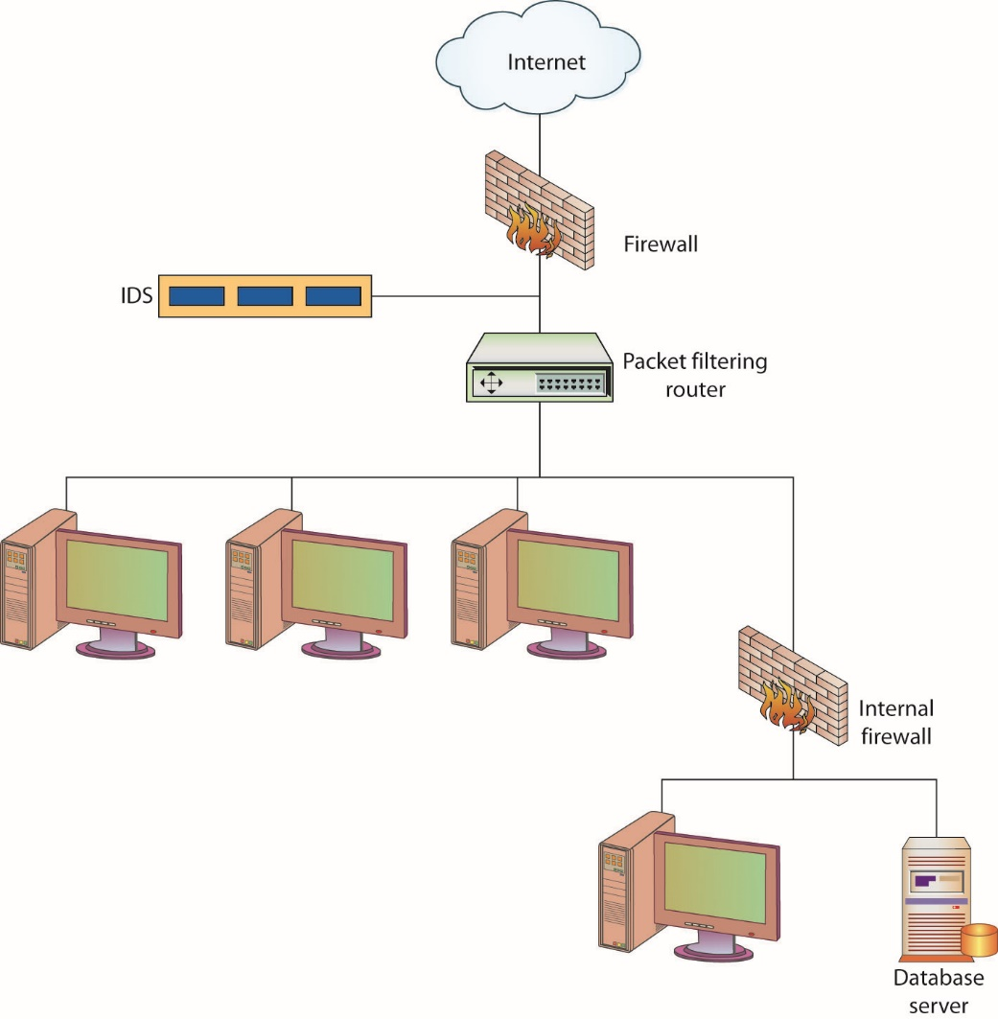
Figure 2.3 Layered security
Notes:
As an example, consider the steps an intruder might have to take to access critical data held within a company’s back-end database.
The intruder first has to penetrate the firewall and use packets and methods that will not be identified and detected by the IDS (more information on these devices can be found in Chapter 13).
The attacker next has to circumvent an internal router performing packet filtering, and then possibly penetrate another firewall used to separate one internal network from another (see Figure 2.3).
From there, the intruder must break the access controls that are on the database, which means having to do a dictionary or brute-force attack to be able to authenticate to the database software.
Once the intruder has gotten this far, the data still needs to be located within the database. This may in turn be complicated by the use of access control lists outlining who can actually view or modify the data. That is a lot of work.
This example illustrates the different layers of security many environments employ. It is important to implement several different layers because if intruders succeed at one layer, you want to be able to stop them at the next. The redundancy of different protection layers assures that there is no one single point of failure pertaining to security. If a network used only a firewall to protect its assets, an attacker able to penetrate this device successfully would find the rest of the network open and vulnerable.

Slide 61
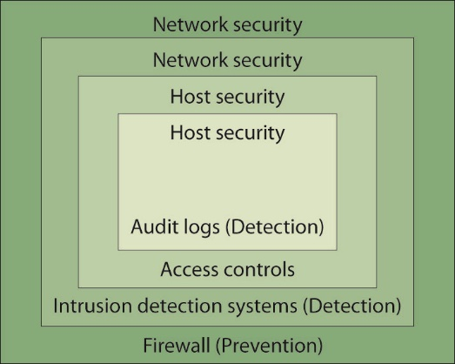
Figure 2.4 Various layers of security
Notes:
An example of how different security methods can work against each other is exemplified when firewalls encounter encrypted network traffic. An organization may utilize encryption so that an outside customer communicating with a specific web server is assured that sensitive data being exchanged is protected. If this encrypted data is encapsulated within Secure Sockets Layer (SSL) or Transport Layer Security (TLS) packets and then sent through a firewall, the firewall may
not be able to read the payload information in the individual packets.
The layers usually are depicted starting at the top, with more general types of protection, and progressing downward through each layer, with increasing granularity at each layer as you get closer to the actual resource. This is because the to player protection mechanism is responsible for looking at an enormous amount of traffic, and it would be overwhelming and cause too much of a performance degradation if each aspect of the packet were inspected. Instead, each layer usually digs deeper into the packet and looks for specific items. Layers that are closer to the resource have to deal with only a fraction of the traffic that the top-layer security mechanism does, and thus looking deeper and at more granular aspects of the traffic will not cause as much of a performance hit.

Slide 62
Security Principles (continued)
Diversity of defense is a concept that complements the idea of various layers of security.
It involves making different layers of security dissimilar.
If attackers know how to get through a system that comprises one layer, they may not know how to get through a different type of layer that employs a different system for security.
Notes:
If an environment has two firewalls that form a demilitarized zone (DMZ), for example, one firewall may be placed at the perimeter of the Internet and the DMZ. This firewall analyzes the traffic that is entering through that specific access point and enforces certain types of restrictions. The other firewall may then be placed between the DMZ and the internal network. When applying the diversity-of-defense concept, you should set up these two firewalls to filter for different types of traffic and provide different types of restrictions. The first firewall, for example, may make sure that no FTP, SNMP, or Telnet traffic enters the network but allow SMTP, SSH, HTTP, and SSL traffic through. The second firewall may not allow SSL or SSH through and may interrogate SMTP and HTTP traffic to make sure that certain types of attacks are not part of that traffic.

Slide 63
Access Control
Access control is the ability to control whether a subject (such as an individual or a process running on a computer system) can interact with an object (such as a file or hardware device).
Authentication deals with verifying the identity of a subject.
It is the process used to verify to the computer system or network that the individual is who they claim to be.
The most common method to do this is through the use of a user ID and password.
Notes:
Once the individual has verified their identity, access controls regulate what the individual can actually do on the system. Just because a person is granted entry to the system does not mean that they should have access to all data the system contains.

Slide 64
Authentication Mechanisms
Access controls define what actions a user can perform or what objects a user is given access.
Access controls assume that the identity of the user has been verified.
Authentication mechanisms are to ensure that only valid users are admitted.
Authentication is using some mechanism to prove that you are who you claim to be.

Slide 65
Authentication Mechanisms (continued)
There are three general factors commonly used in authentication.
Something you know (knowledge factor)
Something you have (possession factor)
Something about you (something that you are; inherent factor)
The most common authentication mechanism provides something the valid user should know.
User ID (or username) and password

Slide 66
Authentication Mechanisms (continued)
The second mechanism for authentication provides something that you have in your possession.
Magnetic stripe card that contains identifying information
The third mechanism for authentication uses something about you for identification purposes.
Fingerprint or the geometry of your hand

Slide 67
Authentication Mechanisms (continued)
Access control vs. authentication
Authentication provides a way to verify to the computer who the user is.
Once the user has been authenticated, the access controls decide what operations the user can perform.
The two go hand-in-hand but they are not the same thing.
Notes:
It may seem that access control and authentication are two ways to describe the same protection mechanism. This, however, is not the case.

Slide 68
Authentication and Access Control Policies
Group policy
This defines for the group things such as the applicable operating system and application settings and permissions.
Password policy
Passwords are the most common authentication mechanism.
The password policy should address the procedures used for selecting user passwords, the frequency with which passwords must be changed, and how passwords will be distributed.
Notes:
Policies are statements of what the organization wants to accomplish. The organization needs to identify goals and intentions for many different aspects of security. Each aspect will have associated policies and procedures.
Operating systems such as Windows and Linux allow administrators to organize users into groups, to create categories of users for which similar access policies can be established. Using groups saves the administrator time, as adding a new user will not require the administrator to create a completely new user profile; instead, the administrator can determine to which group the new user belongs and then add the user to that group.
Examples of groups commonly found include administrator, user, and guest. Take care when creating groups and assigning users to them so that you do not provide more access than is absolutely required for members of that group. It would be simple to make everybody an administrator—it would cut down on the
number of requests users make of beleaguered administrators—but this is not a wise choice, as it also enables users to modify the system in ways that could impact security. Establishing the rights levels of access for the various groups up front will save you time and eliminate potential problems that might be encountered later on.
Procedures for creating new passwords should an employee forget her old password also need to be addressed, as well as the acceptable handling of passwords (for example, they should not be shared with anybody else, they should not be written down, and so on). It might also be useful to have the policy address the issue of password cracking by administrators, to enable them to discover weak passwords selected by employees.
Note that the developer of the password policy and associated procedures can go overboard and create an environment that negatively impacts employee productivity and leads to poorer security, not better. If, for example, the frequency with which passwords are changed is too great, users might write them down or forget them. Neither of these is a desirable outcome, as the former makes it possible for an intruder to find a password and gain access to the system, and the latter leads to too many people losing productivity as they wait for a new password to be created to allow them access again.

Slide 69
Security Models
Confidentiality models
Bell-LaPadula security model addresses data confidentiality in computer operating systems.
Brewer-Nash security model is defined by controlling read and write access based on conflict of interest rules.
Integrity models
Place emphasis on integrity rather than confidentiality.
Biba security model
Clark-Wilson security model
Notes:
An important issue when designing the software that will operate and control secure computer systems and networks is the security model that the system or network will be based upon. The security model will implement the security policy that has been chosen and enforce those characteristics deemed most important by the system designers.
For example, if confidentiality is considered paramount, the model should make certain no data is disclosed to unauthorized individuals. A model enforcing confidentiality may allow unauthorized individuals to modify or delete data, as this would not violate the tenets of the model because the true values for the data would still remain confidential. Of course, this model may not be appropriate for all environments.
In some instances, the unauthorized modification of data may be considered a more serious issue than its unauthorized disclosure. In such cases, the model would be responsible for enforcing the integrity of the data instead of its confidentiality. Choosing the model to base the design on is critical if you want to ensure that the resulting system accurately enforces the security policy desired. This, however, is only the starting point, and it does not imply that you have to make a choice between confidentiality and data integrity, as both are important.

Slide 70
Confidentiality Models
Bell-LaPadula security model employs both mandatory and discretionary access control mechanisms when implementing its two basic security principles.
It addresses data confidentiality in computer operating systems.
It’s two basic security principles are:
Simple Security Rule (“no read up”)
The *-property (pronounced "star property") principle (“no write down”)
Notes:
The U.S. military encouraged the development of the Bell-LaPadula security model to address data confidentiality in computer operating systems. This model is especially useful in designing multilevel security systems that implement the military’s hierarchical security scheme, which includes levels of classification such as Unclassified, Confidential, Secret, and Top Secret. Similar classification schemes can be used in industry, where classifications might include Publicly Releasable, Proprietary, and Company Confidential.
Two basic security principles.
The first of these principles is called the Simple Security Rule, which states that no subject (such as a user or a program) can read information from an object (such as a file) with a security classification higher than that possessed by the subject itself. This means that the system must prevent a user with only a Secret clearance, for example, from reading a document labeled Top Secret. This rule is often referred to as the “no-readup” rule.
The second security principle enforced by the Bell-LaPadula security model is known as the *-property (pronounced “star property”). This principle states that a subject can write to an object only if the target’s security classification is greater than or equal to the object’s security classification. This means that a user with a Secret clearance can write to a file with a Secret or Top Secret classification but cannot write to a file with only an Unclassified classification. This at first may appear to be a bit confusing, since this principle allows users to write to files that they are not allowed to view, thus enabling them to actually destroy files that they don’t have the classification to see. This is true, but keep in mind that the Bell-LaPadula model is designed to enforce confidentiality, not integrity. Writing to a file that you don’t have the clearance to view is not considered a confidentiality issue; it is an integrity issue.

Slide 71
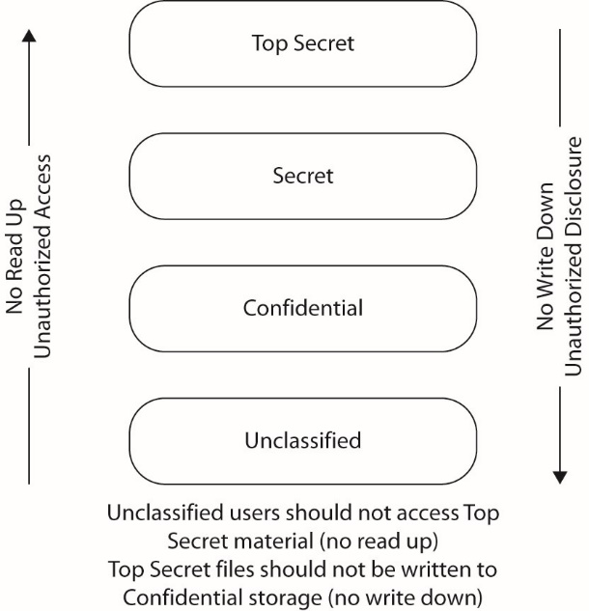
Figure 2.5 Bell-LaPadula security model

Slide 72
Confidentiality Models (continued)
Brewer-Nash security model is defined by controlling read and write access based on conflict of interest rules.
This model is also known as the Chinese Wall model, after the concept of separating groups through the use of an impenetrable wall.
It takes into account user conflict-of-interest aspects.
Information flows are modeled to prevent information from flowing between subjects and objects when a conflict of interest would occur.
Notes:
One of the tenets associated with access is need to know. Separate groups within an organization may have differing needs with respect to access to information. A security model that takes into account user conflict-of-interest aspects is the Brewer-Nash security model.

Slide 73
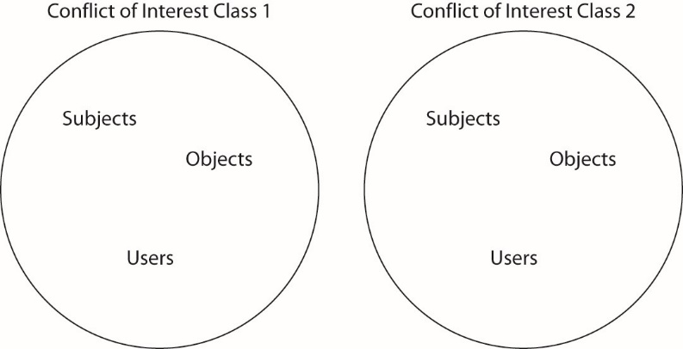
Figure 2.6 Brewer-Nash security model
Notes:
Separate groups are defined and access controls are designed to enforce the separation of the groups.

Slide 74
Integrity Models
Biba security model
Two principles based on integrity levels
Low-Water-Mark policy (“no write up”) prevents unauthorized modification of data
Ring policy (“no read down”) allows any subject to read any object without regard to the object’s level of integrity and without lowering the subject’s integrity level
Objective – protect integrity
Notes:
A principle of integrity levels is that data with a higher integrity level is believed to be more accurate or reliable than data with a lower integrity level. Integrity levels indicate the level of “trust” that can be placed in information at the different levels. Integrity levels differ from security levels in another way—they limit the modification of information as opposed to the flow of information.
An initial attempt at implementing an integrity-based model was captured in what is referred to as the Low-water-mark policy. This policy in many ways is the opposite of the *-property in that it prevents subjects from writing to objects of a higher integrity level. The policy also contains a second rule that states the integrity level of a subject will be lowered if it reads an object of a lower integrity level. The reason for this is that if the subject then uses data from that object, the highest the integrity level can be for a new object created from it is the same level of integrity of the original object. In other words, the level of trust you can place in data formed from data at a specific integrity level cannot be higher than the level of trust you have in the subject creating the new data object, and the level of trust you have in the subject can only be as high as the level of trust you had in the original data. The final rule contained in the Low-Water-Mark policy states that a subject can execute a program only if the program’s integrity level is equal to or less than the integrity level of the subject. This ensures that data modified by a program only has the level of trust (integrity level) that can be placed in the individual who executed the program.
While the Low-Water-Mark policy certainly prevents unauthorized modification of data, it has the unfortunate side effect of eventually lowering the integrity levels of all subjects to the lowest level on the system (unless the subject always views files with the same level of integrity). This is because of the second rule, which lowers the integrity level of the subject after accessing an object of a lower integrity level. There is no way specified in the policy to ever raise the subject’s integrity level back to its original value. A second policy, known as the Ring policy, addresses this issue by allowing any subject to read any object without regard to the object’s level of integrity and without lowering the subject’s integrity level. This, unfortunately, can lead to a situation where data created by a subject after reading data of a lower integrity level could end up having a higher level of trust placed upon it than it should.
The Biba security model implements a hybrid of the Ring and LowWater-Mark policies. Biba’s model in many respects is the opposite of the Bell-LaPadula model in that what it enforces are “no-read-down” and “nowrite-up” policies. It also implements a third rule that prevents subjects from executing programs of a higher level. The Biba security model thus addresses the problems mentioned with both the Ring and Low-WaterMark policies.

Slide 75
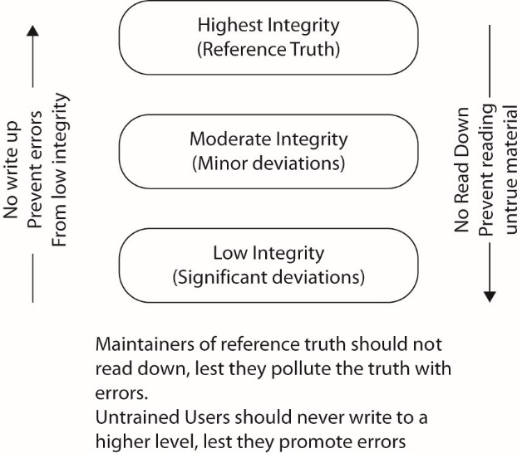
Figure 2.7 Bibb Security Model

Slide 76
Integrity Models (continued)
Clark-Wilson security model
Uses transactions as a basis for rules
Two levels of integrity
Constrained data items (CDI) are subject to integrity controls.
Unconstrained data items (UDI) are not subject to integrity controls.
Two types of processes
The first are integrity verification processes (IVPs).
The second are transformation processes (TPs).
Notes:
The Clark-Wilson security model takes an entirely different approach than the Biba and Bell-LaPadula models, using transactions as the basis for its rules. It defines two levels of integrity only: constrained data items (CDIs) and unconstrained data items (UDIs). CDI data is subject to integrity controls while UDI data is not. The model then defines two types of processes: integrity verification processes (IVPs), which ensure that CDI data meets integrity constraints (to ensure the system is in a valid state), and transformation processes (TPs), which change the state of data from one valid state to another. Data in this model cannot be modified directly by a user; it must be changed by trusted TPs, access to which can be restricted (thus restricting the ability of a user to perform certain activities).
It is useful to return to the prior example of the banking account balance to describe the need for integrity-based models. In the Clark-Wilson model, the account balance would be a CDI because its integrity is a critical function for the bank. A client’s color preference for their checkbook is not a critical function and would be considered a UDI. Since the integrity of account balances is of extreme importance, changes to a person’s balance must be accomplished through the use of a TP.
Ensuring that the balance is correct would be the duty of an IVP. Only certain employees of the bank should have the ability to modify an individual’s account, which can be controlled by limiting the number of individuals who have the authority to execute TPs that result in account modification. Certain very critical functions may actually be split into multiple TPs to enforce another important principle, separation of duties (introduced earlier in the chapter). This limits the authority any one individual has so that multiple individuals will be required to execute certain critical functions.

